Slide 1
Crop Production Analysis
By Rima Nandy

Slide 2
Data Source
Primary Crop Production Data provided by Indian Government from 1977 to 2015
Data contains detailed description under the following sections:
State Name, District Name, Crop Year, Season, Crop type, Area and Production

Slide 3
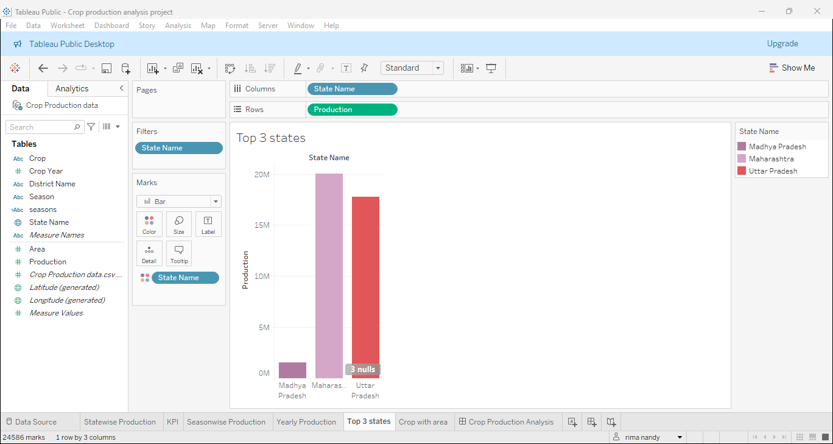
Highest Crop Producing States

Slide 4
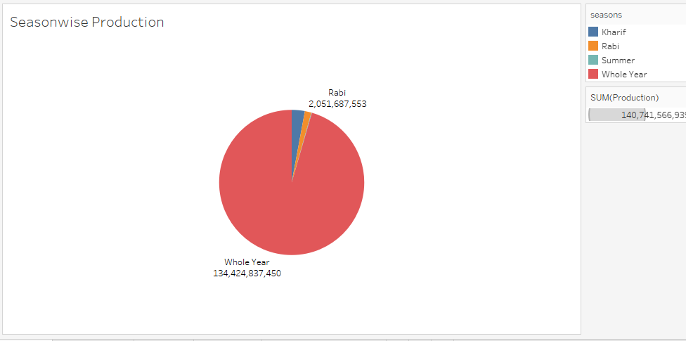
Season wise Production

Slide 5
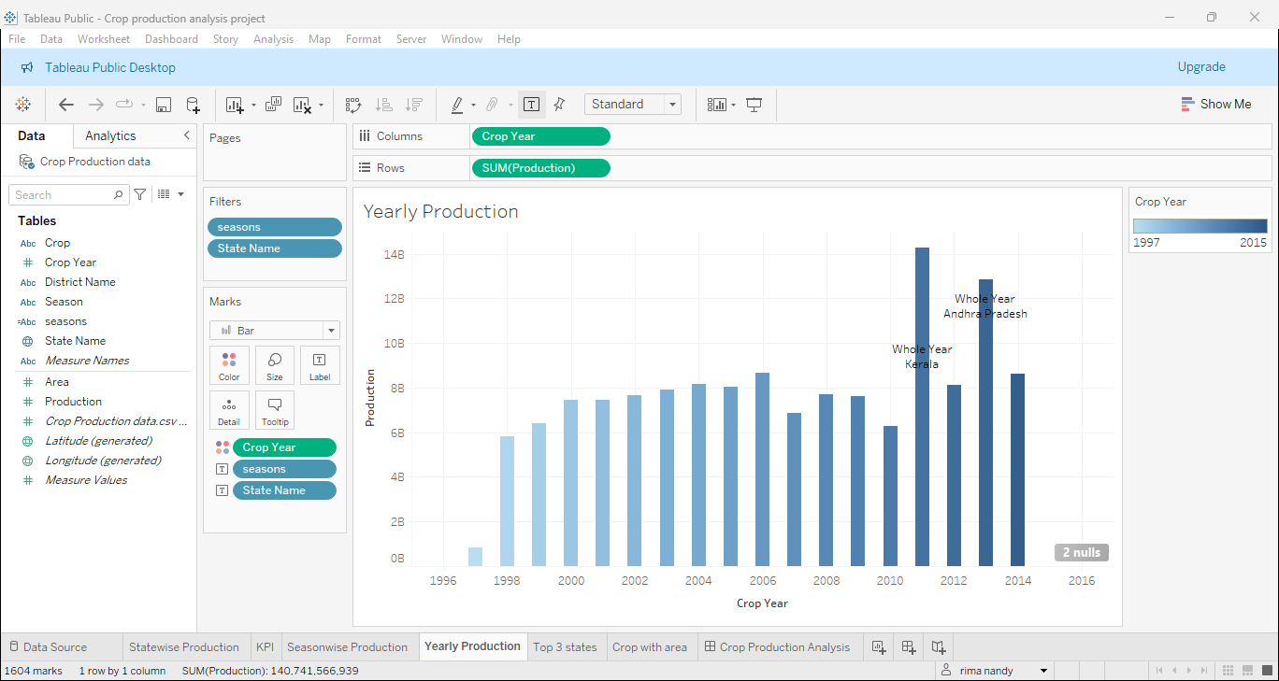
Yearly Production

Slide 6
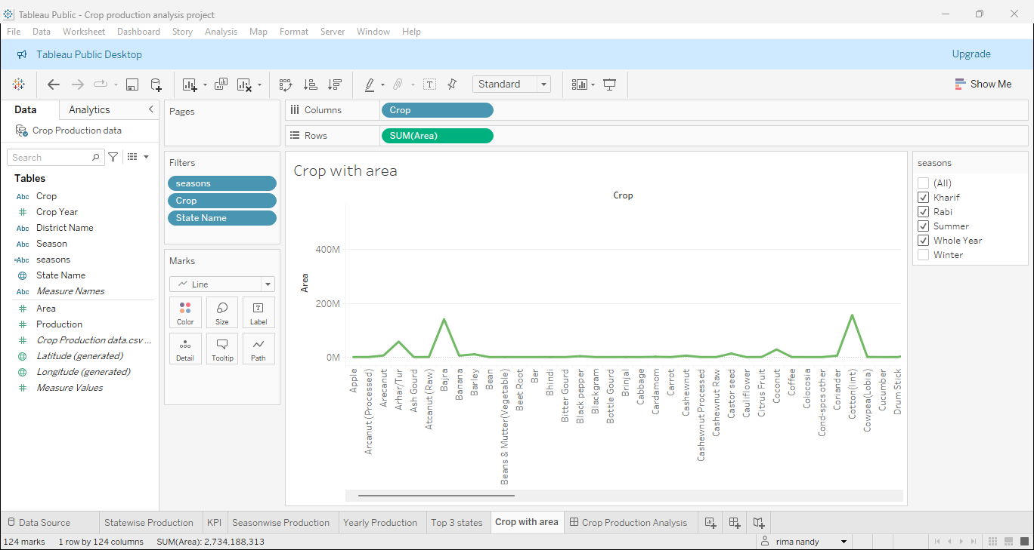
Area under crop production

Slide 7
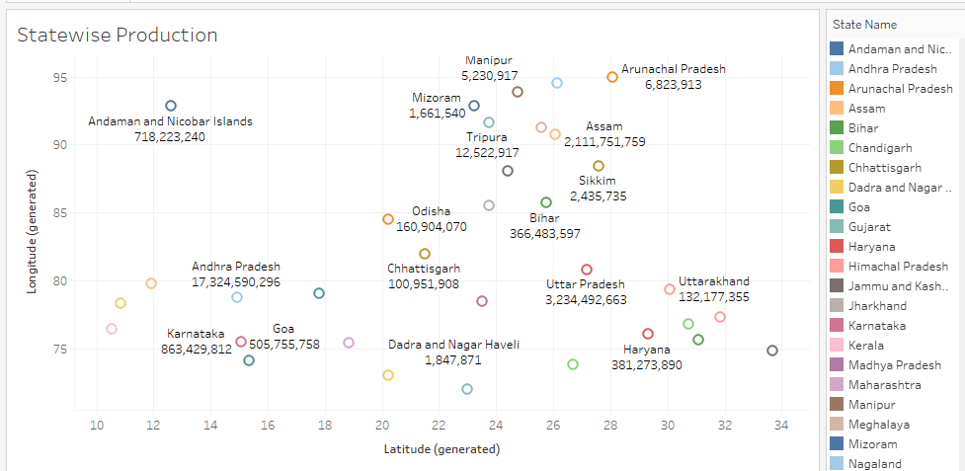
State wise production

Slide 8
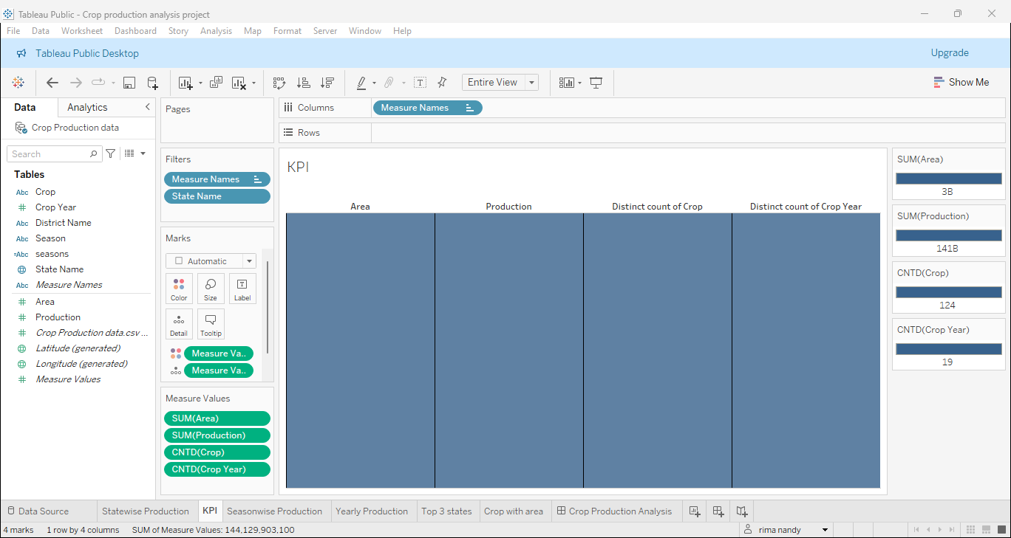
Key Performance Indicators

Slide 9
Detailed Project Analysis Report
From the detailed analysis performed in Tableau, the following points can be duly ascertained:
The top 3 highest crop producing states are – Maharashtra, Uttar Pradesh and Madhya Pradesh.
In season wise analysis, Rabi crops are produced higher than Kharif crops.
Kerala has the highest production of crops throughout the year.
Crops like bajra and cotton are cultivated with the highest area amongst all the crops.
KPI metrics show the area of cultivation is directly linked to the production of crops.
Overall between the years of 1977-2015, a total distinct variety of 124 crops was cultivated in an overall area of 3 billion acre which lead to the production of 141 billion of crops.

Slide 10
Thank You

